Slide 1
PEIMS
PUBLIC EDUCATION INFORMATION
MANAGEMENT SYSTEM
Mary Morgan - Lead PEIMS Specialist
817-740-7679 mmorgan@esc11.net
Lynne Summerlin – Lead TSDS Specialist
817-740-7679 lsummerlin@esc11.net
Deanna Harris – PEIMS Specialist
817-740-3677 deanna.harris@esc11.net
Region 11 Education Service Center
Copyright © 2022 Education Service Center Region 11

Slide 2
Survival Skills:
New District PEIMS Coordinators
        P - Public
        E - Education
        I - Information
        M - Management
        S - System
Copyright © 2022 Education Service Center Region 11

Slide 3
Topics that will be discussed today
History of PEIMS
Navigating the following websites
  TEA Homepage
  TWEDS (Texas Web-Enabled Education Data Standards)
  SAAH (Student Attendance Accounting Handbook)
  AskTED
  TSDS/UID/ET
  TSDS TIMS
  Correspondence from TEA
  Texas Education Code (TEC)
  Texas Administrative Code (TAC)
FERPA
22/23 TSDS Submission/Resubmission Timelines
What Systems do I need?
  TEAL
  TREx
  TSDS
    PEIMS
    Unique ID
    ET
    Charter School Waitlist
    Child Find
    CR (Class Roster)
    ECDS (Early Childhood Data System)
    RFT (Residential Facility Treatment)
    SELA (Special Education Language Acquisition
    SPPI-14 (State Performance Plan Indicator 14
Copyright © 2022 Education Service Center Region 11

Slide 4
Student Attendance Accounting Handbook
  Audit Documentation Required
  Reports for 6-Week Reporting Period
  Attendance System Procedures Manual
TWEDS Texas Web-enabled Education Data Standards
Review
PEIMS is a collection of information. Organizations requiring accountability have always requested and received information from school districts:
Texas Education Agency
State Legislature
Federal Government
PEIMS encompasses student demographic information, student academic performance, personnel, financial and organizational information.
PEIMS data requirements are constantly evolving. The amount of data currently being submitted has grown dramatically since the first PEIMS submissions. Additions to the PEIMS data requirements are based on decisions made by the legislature or by data needs mandated by the federal government.
Copyright © 2022 Education Service Center Region 11

Slide 5
PEIMS Collection of Data
Data collection through PEIMS began Fall 1987
Streamline reporting under one umbrella
Reduce Duplication
Standard set of education-related data definitions
A more business-like way to collect information.
    Standard definitions
    Automation
    Timelines
    Accuracy
  PEIMS reporting is not optional.

Slide 6
What is TSDS PEIMS?
TSDS PEIMS
Business Rules
Interchange Schemas (contains categories, complex and elements)
Data Edits (fatals, warnings, special warnings)
Statement of Approval (SOA)
One Resubmission Opportunity per Submission
TSDS is a statewide system for collecting and reporting education data for publicly funded schools in the State of Texas. TSDS offers a way to collect and manage data, as well as provides educators with timely, actionable, and historical student data.
PEIMS data collection is required of all LEAs by TEC §42.006.
Copyright © 2022 Education Service Center Region 11

Slide 7
Currently, the major categories of data collected are:
organizational,
budget,
actual financial,
staff,
student demographic,
program participation,
school leaver,
student attendance,
course completion, and
discipline.
TEA manages other collections for evaluation, monitoring, funding, or auditing. Many are automated, electronic collections.
In compliance with the Texas Education Code, PEIMS contains only the data necessary for the legislature and TEA to perform their legally authorized functions in overseeing public education.
Copyright © 2022 Education Service Center Region 11

Slide 8
What is PEIMS Used For?
The data that is reported to the Public Education Information Management System (PEIMS) is used to analyze Texas public education data through data reports, evaluations, Texas Academic Performance Reports/Accountability ratings, and funding calculations.
The collection of TSDS data is used to populate the Education Data Warehouse (EDW). The collection of this data is used by the LEAs for required state and federal reporting. TEDS provides instructions regarding the submission of the TSDS data from those LEAs to the Texas Education Agency.
Copyright © 2022 Education Service Center Region 11

Slide 9
Important Links
All documents are available on the web at TEA’s website
https://tea.texas.gov/
Texas Education Data Standards (TEDS)
https://www.texasstudentdatasystem.org/TSDS/TEDS/TEDS_Latest_Release
  Student Attendance Accounting Handbook (SAAH)
  https://tea.texas.gov/Finance_and_Grants/Financial_Compliance/Student__Attendance_Accounting_Handbook/
Financial Accountability System Resource Guide (FASRG)
http://tea.texas.gov/Finance_and_Grants/Financial_Accountability/Financial__Accountability_System_Resource_Guide
Copyright © 2022 Education Service Center Region 11

Slide 10

  AskTED
  AskTED Home (state.tx.us)
  Texas Administrative Code (TAC)
  http://ritter.tea.state.tx.us/rules/tac/index.html
  Texas Education Code (TEC)
  http://www.statutes.legis.state.tx.us/
  Correspondence from TEA
  http://www.tea.state.tx.us/taa_letters.aspx
US Department of Education-FERPA
https://www2.ed.gov/policy/gen/guid/fpco/ferpa/index.html
Copyright © 2022 Education Service Center Region 11

Slide 11
FERPA
GENERAL
Family Educational Rights and Privacy Act (FERPA)
Family Policy Compliance Office (FPCO) Home
The Family Educational Rights and Privacy Act (FERPA) (20 U.S.C. § 1232g; 34 CFR Part 99) is a Federal law that protects the privacy of student education records. The law applies to all schools that receive funds under an applicable program of the U.S. Department of Education.
FERPA gives parents certain rights with respect to their children's education records. These rights transfer to the student when he or she reaches the age of 18 or attends a school beyond the high school level. Students to whom the rights have transferred are "eligible students."
Parents or eligible students have the right to inspect and review the student's education records maintained by the school. Schools are not required to provide copies of records unless, for reasons such as great distance, it is impossible for parents or eligible students to review the records. Schools may charge a fee for copies.
Parents or eligible students have the right to request that a school correct records which they believe to be inaccurate or misleading. If the school decides not to amend the record, the parent or eligible student then has the right to a formal hearing. After the hearing, if the school still decides not to amend the record, the parent or eligible student has the right to place a statement with the record setting forth his or her view about the contested information.
Copyright © 2022 Education Service Center Region 11

Slide 12
Generally, schools must have written permission from the parent or eligible student in order to release any information from a student's education record. However, FERPA allows schools to disclose those records, without consent, to the following parties or under the following conditions (34 CFR § 99.31):
  School officials with legitimate educational interest;
  Other schools to which a student is transferring;
  Specified officials for audit or evaluation purposes;
  Appropriate parties in connection with financial aid to a student;
  Organizations conducting certain studies for or on behalf of the school;
  Accrediting organizations;
  To comply with a judicial order or lawfully issued subpoena;
  Appropriate officials in cases of health and safety emergencies; and
  State and local authorities, within a juvenile justice system, pursuant to specific State law.
Schools may disclose, without consent, "directory" information such as a student's name, address, telephone number, date and place of birth, honors and awards, and dates of attendance. However, schools must tell parents and eligible students about directory information and allow parents and eligible students a reasonable amount of time to request that the school not disclose directory information about them. Schools must notify parents and eligible students annually of their rights under FERPA. The actual means of notification (special letter, inclusion in a PTA bulletin, student handbook, or newspaper article) is left to the discretion of each school.
Copyright © 2022 Education Service Center Region 11

Slide 13
2022-2023
TSDS PEIMS Submission & Resubmission Timelines &
Core Collection Timelines
Copyright © 2022 Education Service Center Region 11

Slide 14
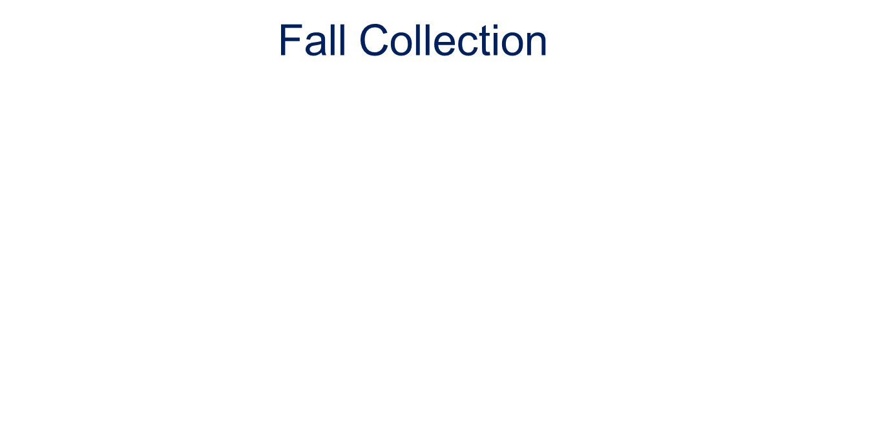
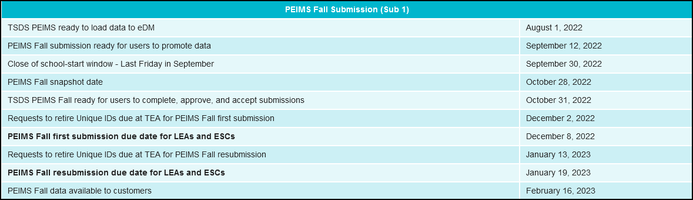
Collection 1 represents the state of LEAs as of the Fall Snapshot date. Although the Fall Snapshot Date may not be a day of instruction, LEAs still report all students served and staff employed on that date. Exception: Leaver data are reported based on leaver status as of the last Friday in September. ESCs and LEAs shall report current school year budget data. All LEAs report data for the PEIMS Fall submission.
PEIMS Collects – Staff Data, Budget Data, and Student Data
(Leavers and Dropouts)
Copyright © 2022 Education Service Center Region 11

Slide 15
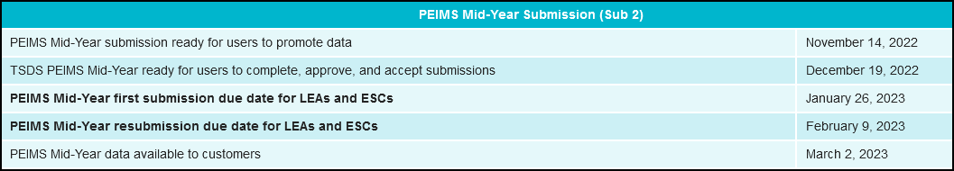
Mid-year Collection 2
Collection 2 includes the audited actual financial data for the prior school year. All LEAs promote data for the PEIMS Mid-year submission.
Copyright © 2022 Education Service Center Region 11

Slide 16
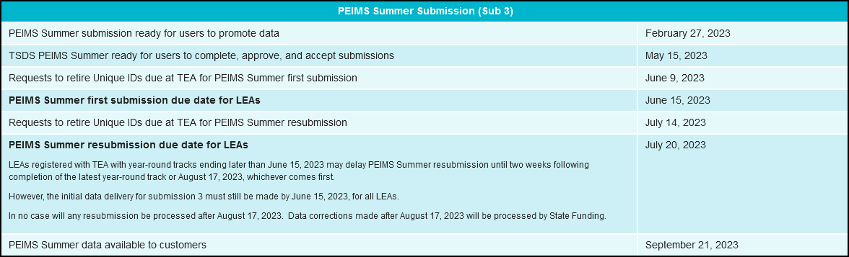
Summer Collection 3
Collection 3 includes year long student attendance (regular and flexible), course completions (high school courses, Texas Virtual School Network (TxVSN) Online Schools program courses, and TxVSN Statewide Online Course Catalog courses), disciplinary actions, student restraints, Title I, Part A participation, course sections, teacher class assignments/staff data, district/charter school and campus performance ratings, school board requests, and Foundation High School Program participation data.
Summer data are used to:
  Calculate FSP final allotments
  Calculate attendance and course completion
  Create a portion of TAPR
  Perform desk audits
CCMR/Accountability
Copyright © 2022 Education Service Center Region 11

Slide 17
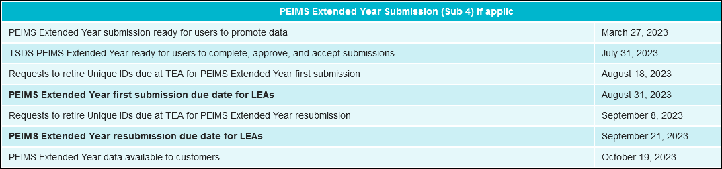
Extended Collection
Collection 4 includes special education extended year services (ESY) student data, Bilingual/ESL Summer School, Additional Days School Year (ADSY) program, student flexible attendance for credit recovery, summer- time dual credit course completions for students, high school CTE course completions and CP ELA and CP Math.
Only LEAs offering one of these described programs are required to report date for the PEIMS Extended Year submission.
Copyright © 2022 Education Service Center Region 11

Slide 18
What system(s) access do I need?
TEAL
TSDS PEIMS/UID/ET/TIMS
  Core Collection
    Charter School Waitlist
    Child Find
    Class Roster
    ECDS
    RFT
    Special Education Language Acquisition
    SPPI-14
TREx
Copyright © 2022 Education Service Center Region 11

Slide 19
What is TEAL?
The Texas Education Agency Login (TEAL) provides a secure gateway to log in to TEA web applications. Only one account (user name/password) is needed to access numerous TEA applications. TEAL also provides functionality so that organizations can manage user application accounts. Currently many TEA web applications are using the older login environment, TEASE, but over time most TEA applications will migrate to TEAL.
Once you have a TEAL account, you may link your other accounts to the TEAL account.
Copyright © 2022 Education Service Center Region 11

Slide 20
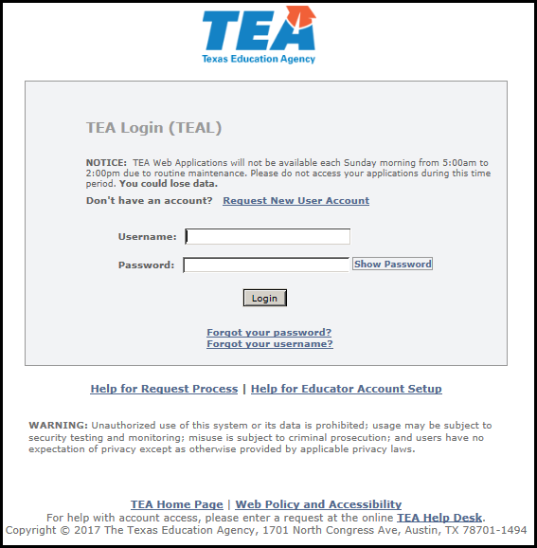
https://pryor.tea.state.tx.us/TSP/TEASecurePortal/Access/LogonServlet

Slide 21
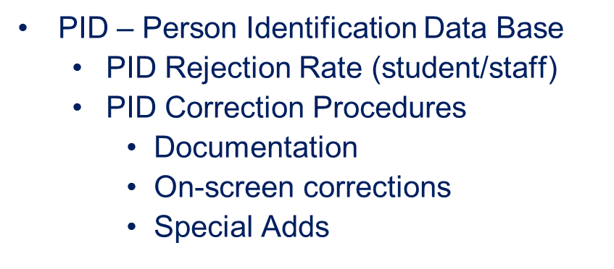
What is UNIQUE – ID?
TEA provides an application called UNIQUE-ID which maintains a unique identifier database entry for every student and staff within the Texas public school and open enrollment Charter system. The UNIQUE-ID application allows authorized ESC, district or campus users the ability to search for existing students or staff within the UNIQUE-ID database. Users with either UIDLEA or UIDCAMPUS roles within the UNIQUE-ID application may also add a new student/staff to or update an existing student/staff in the database.
These features allow districts to correct errors before submitting their PEIMS data to TEA.
Copyright © 2022 Education Service Center Region 11

Slide 22
What is ET ?
The Enrollment Tracking (ET) application is designed as an extension to PID (Person Identification Database). It provides districts and open-enrollment charter schools the ability to maintain student information via ET events. An ET event is an individual student's enrollment to or withdrawal from a campus ID of enrollment coupled with the date the event took place. ET events are part of a student's PID record and can be very helpful when a district needs to identify any previous Texas districts of enrollment for students newly enrolled in their districts.
Each week school is in session (if there is a change/update) beginning the second Friday in September.
Tracks students throughout…
Get accurate data at enrollment…
See student’s enrollment history…
Helps locate Texas movers…
Avoid duplicate enrollment…
Copyright © 2022 Education Service Center Region 11

Slide 23
Core Collections
Copyright © 2022 Education Service Center Region 11

Slide 24
Charter School Waitlist
The purpose of the Charter School Waitlist Collection is to meet the requirements of TEC Chapter 12, Subchapter D, Section 12.1174 by collecting information about enrollment and the use of a waiting list.
Texas Education Code (TEC), §12.1174, added by SB 2293, Texas Legislature, 86th Regular Session, 2019, requires that the governing body of a charter school report certain student enrollment and waitlist data to TEA no later than the last Friday of October of each school year. Students who have applied but are not enrolled in the charter school and who are on a waitlist, must be reported to the agency in addition to the number of students enrolled and the educational enrollment capacity.
All data must be reported as of the last Friday in September and the data is due to the agency by the close of the collection on the last Friday in October.
Copyright © 2022 Education Service Center Region 11

Slide 25
Child Find
Child Find combines State Performance Plan Indicator 11 (SPPI-11) and State Performance Plan Indicator 12 (SPPI-12) in the TSDS Core Collection. SPPI-11 refers to the timely evaluation of students, ages 3-21, for special education services under Part B of IDEA. SPPI-12 refers to children who are referred from Part C of IDEA prior to age 3, found eligible for Part B of IDEA, and have an individualized education plan (IEP) developed and implemented by their third birthday to receive early childhood special education (ECSE) services from a local education agency (LEA). Both SPPI-11 and SPPI-12 are compliance indicators and data are needed to meet federal reporting requirements related to special education Child Find activities.
Copyright © 2022 Education Service Center Region 11

Slide 26
Class Roster (CR)
The Class Roster collection is used to report data about course offerings, teacher demographics, teacher class assignments, student demographics, and student class enrollments. The data is used to create a student assessment data portal accessible by school districts, teachers, parents, students, and public institutions of higher education. Class Roster collects information in advance of and close to the time assessments are administered so that vendors can link that student to their correct teachers. This allows the TEA to provide assessment results through the assessment portal at the individual classroom level.
Copyright © 2022 Education Service Center Region 11

Slide 27
Early Childhood Data System (ECDS)
The purpose of the ECDS Collection is to inform parents, school administrators, the public, statewide stakeholders, community, and policymakers about the quality of early childhood education and help direct resources in an informed manner.
Copyright © 2022 Education Service Center Region 11

Slide 28
Residential Facility Tracker (RFT)
The purpose of the RF Tracker Collection is to oversee and monitor the programs provided to students with disabilities who reside in residential facilities (RFs).
Each LEA with a Residential Facility within its boundaries or jurisdiction, in which students with disabilities reside, must validate the data collection by December 3, 2021, as outlined in the Texas Education Data Standards (TEDS). The RF Tracker application will remain open for data entry after December 3, 2021, as LEAs are required to maintain current and accurate records in the system. LEAs must validate and complete the RF tracker submission by July 21, 2022.
A Residential Facility, for this purpose, is defined as a facility that provides 24-hour custody or care of students 22 years of age or younger who reside in the facility for detention, treatment, foster care, or any non-educational purpose.
A Residential Facility is NOT a traditional foster home licensed by the Texas Department of Family and Protective Services.
Copyright © 2022 Education Service Center Region 11

Slide 29
Special Education Language Acquisition (SELA)
House Bill (HB) 548, passed in the 86th Legislative Session, amends Subchapter I, Chapter 29, Education Code by adding Section 29.316. This section requires the commissioner of the Texas Education Agency and the executive commissioner of the Health and Human Services Commission (HHSC) to ensure that the language acquisition of each child eight years of age or younger who is deaf or hard of hearing is regularly assessed using a tool or assessment. Additionally, no later than August 31 of each year, a report shall be published on the language acquisition of children eight years of age or younger who are deaf or hard of hearing.
The Special Education Language Acquisition (SELA) collection will report data on the language acquisition of children eight years of age or younger who are deaf or hard of hearing, identified with an auditory impairment or deaf/blind using the following DISABILITY-TYPE codes: ’02’ Deaf-Blindness (Deaf-Blind) or ‘06’ Deaf And Hard Of Hearing. The StudentSpecialEdProgramAssociationExtension complex type will be used to gather information about language acquisition services being provided to deaf or hard of hearing students.
Copyright © 2022 Education Service Center Region 11

Slide 30
State Performance Plan Indicator 14 (SPPI-14)
SPPI-14 requires that a Post-School Outcome Survey be distributed to persons who received special education services prior to exiting high school.
The SPPI-14 data submission collects student and parent/guardian contact information for students who were served through the Special Education Program in the prior school year and who did not return to the LEA in the current school year.
Once data is submitted through TSDS, TEA will provide a Third-Party Vendor with a pool of students to sample.
The survey results are submitted to the Office of Special Education Programs at the U.S. Department of Education with annual progress reports related to the State Performance Plan.
Copyright © 2022 Education Service Center Region 11

Slide 31
TREx – TX Records Exchange
The Texas Records Exchange (TREx) system is a web-based software application designed for the exchange of electronic student records as mandated by the State. By using TREx, school registrars have the ability to electronically request and receive student records for students who have attended or will be attending Texas public schools. High school registrars and counselors also have the ability to electronically create and send official student transcripts to Texas public colleges and universities using TRex to access the University of Texas (UT) SPEEDE Server.
If you already have a user name and password for another TEA application, log on to TEAL and select "Add/Modify Application Access" from Application List page.
Copyright © 2022 Education Service Center Region 11

Slide 32
Student Attendance
Accounting Handbook https://tea.texas.gov/Finance_and_Grants/Financial_Compliance/Student__Attendance_Accounting_Handbook
Published annually by TEA (on web site)
Student attendance accounting system requirements
Foundation School Program eligibility
Funding implications
Special program eligibility and contact hours
Documentation requirements for attendance audit purposes
Details, the responsibilities of all persons who work with student attendance in the district
The proposed version of the 2022-23 SAAH ……
Copyright © 2022 Education Service Center Region 11

Slide 33
The handbook contains thirteen sections which include as follows:
Section 1 Overview
Section 2 Audit Requirements
Section 3 General Attendance Requirements
Section 4 Special Education
Section 5 Career and Technical Education
Section 6 Bilingual/English as a Second Language (ESL)
      Emergent Bilingual (EB)
Section 7 Prekindergarten (Pre-K)
Section 8 Gifted and Talented
Section 9 Pregnancy Related Services (PRS)
Section 10 Alternative Education Programs (AEPs) and Disciplinary Removals
Section 11 Nontraditional Programs
Section 12 Virtual, Remote, and Electronic Instruction
Section 13 Appendix: Average Daily Attendance and Funding,
Glossary, and Resources
Copyright © 2022 Education Service Center Region 11

Slide 34
Overview
The primary purpose for TEA’s collection of student attendance data is to ensure that FSP funds can be allocated to Texas’s public schools. All public schools in Texas must maintain records to reflect the average daily attendance (ADA) for the allocation of these and other funds by[the] TEA.
Note: An inherent difference exists between being permitted to serve a student in a particular program and being entitled to funding for the service provided to the student. For example, depending on local policy, your school district may serve virtually any student in virtually any capacity or setting as-long-as serving the student does not interfere with the education of funding-eligible students. However, the only circumstance in which a student may be coded as an eligible participant in a program or setting, thereby generating state funding, is one in which the student meets all eligibility requirements and all documentation is complete and on file.
Copyright © 2022 Education Service Center Region 11

Slide 35
Important: Your district must not assign attendance personnel the responsibility of determining a student’s coding information. Special program staff members, directors, or teachers should
provide attendance personnel with names and coding information of students who are eligible and whose documentation is in order. Special program directors and staff members are responsible for reviewing special program data and totals for accuracy and completeness. They are also
responsible for ensuring that attendance personnel are aware of any changes in a student’s services and the effective dates of those changes. The attendance personnel are then responsible
for entering the changes in the student attendance accounting system. At the end of each six-week reporting period, special program staff members should check the Student Detail Report for any coding errors.
Copyright © 2022 Education Service Center Region 11

Slide 36
Audit Documentation Required
Regardless of where attendance records are filed or stored, they must be readily available for audit by the Financial Compliance Division of TEA. Auditors have the authority to examine attendance records for any year for which your district is required to retain records.
If auditors detect errors during an audit, TEA will either assess an adjustment to subsequent allocations of state funds or require your district to refund the total amount of the adjustment when the audit is finalized. Incomplete or inaccurate data will result in attendance not being allowed.
Copyright © 2022 Education Service Center Region 11

Slide 37
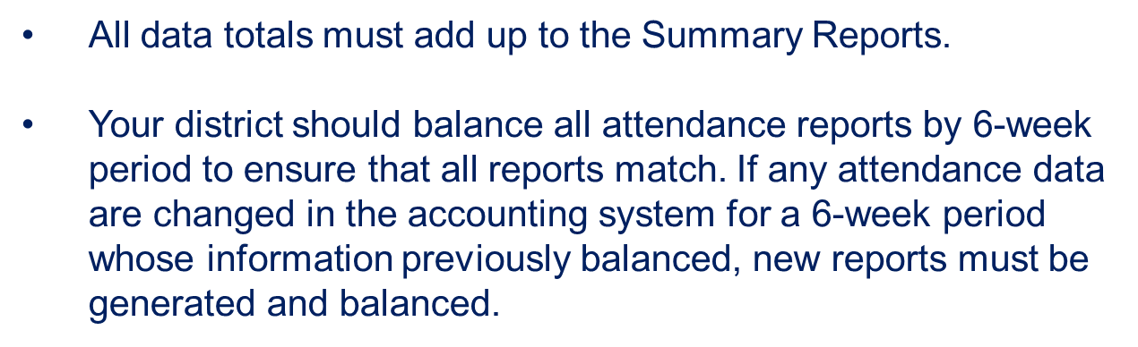
Reports for each 6-week Reporting Period
Your district must generate the following reports for each six week reporting period:
Student Detail Reports (SAAH 2.3.1)
Campus Summary Reports (SAAH 2.3.2)
District Summary Reports (SAAH 2.3.3)
Reconciliation of Teachers Roster
& Attendance Records (SAAH 2.3.4)
Additional Required Documentation (SAAH 2.3.5)
***For schools offering multiple tracks, student detail must be summarized by individual tracks.
Copyright © 2022 Education Service Center Region 11

Slide 38
Attendance System Procedures Manual
2.2.5
Your district or charter school must maintain a procedures manual that provides specific, detailed information on the district’s school attendance accounting system. This procedure manual must include the following information:
  how and when teachers are to take official attendance
  how attendance is entered into the attendance accounting system
  which position or positions are responsible for the coding of special programs (such as career and technical education, special education, pregnancy-related services, etc.)
  how changes to special programs are to be documented
  how student membership is to be reconciled between the teacher rosters and the attendance accounting database
  how your district will maintain attendance accounting records (including computerized records, period absence slips, and official calendar) after the completion of the school year
  what backup systems are in place to protect the attendance accounting records
  which position is responsible for the maintenance and security of the attendance accounting records
  Copyright © 2022 Education Service Center Region 11

Slide 39
What is PEIMS Used For?
  Main support for Foundation School Program funding
  Accountability and Accreditation
  State and Federal Reporting
  District Effectiveness and Compliance Monitoring
  School Financial and Desktop Audits
  Budget Forecasting
  Copyright © 2022 Education Service Center Region 11

Slide 40
What is TEDS?
Texas Education Data Standards: are XML-based standards for Texas Student Data System(TSDS) and TSDS PEIMS data collections. TEDS includes all data elements, code tables, business rules and data validations needed to load LEA education.
The current XML-based data standards are hosted on TSDS Web-Enabled Data Standards (TWEDS).
The Texas Education Data Standards (TEDS) is for all persons involved in the data collection process, including LEA administrators, special program personnel, data control personnel, data processing staff, service center coordinators, and others. The Texas Education Data Standards is for data delivery only. It should not be construed to represent the format of data available for retrieval from the database.
  Copyright © 2022 Education Service Center Region 11

Slide 41
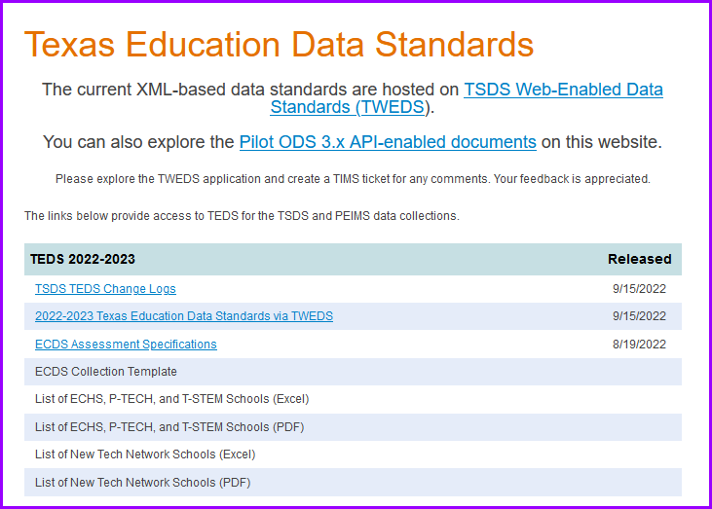
  Copyright © 2022 Education Service Center Region 11

Slide 42
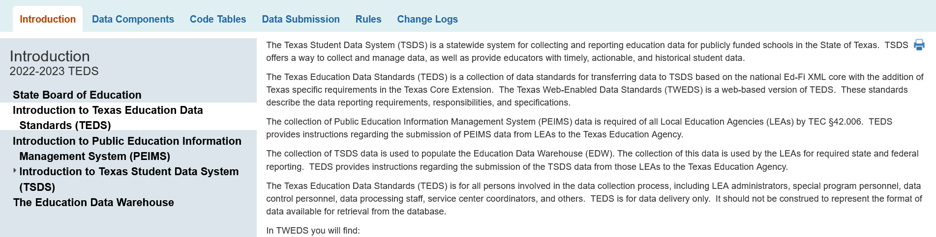
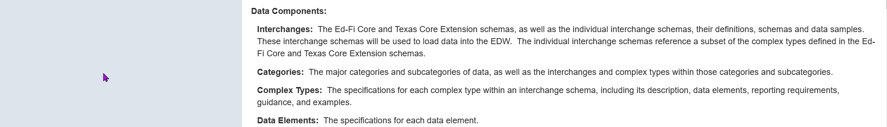
  Copyright © 2022 Education Service Center Region 11

Slide 43
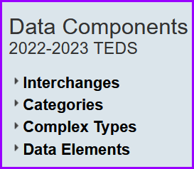
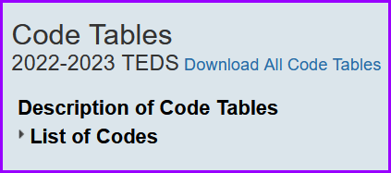
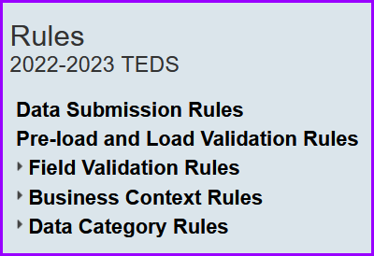
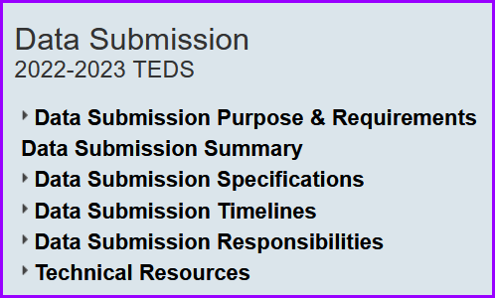
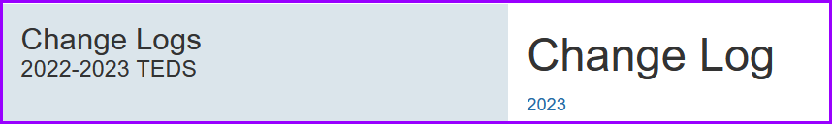
  Copyright © 2022 Education Service Center Region 11

Slide 44
District PEIMS Coordinators Responsibilities
Stay current of Data Standards and Student Attendance Handbook Updates /Changes.
Encourage PEIMS clerical/professional staff to attend PEIMS and software vendor training.
Review Campus PEIMS Edits, Summary/Reports from TSDS PEIMS, and TEA Diagnostic Reports for accuracy.
Make necessary data corrections for submission and/or resubmission.
Meet the data delivery schedules established by TEA and ESC 11.
  Copyright © 2022 Education Service Center Region 11

Slide 45
District PEIMS Coordinators Responsibilities cont.
Important: Your district must not assign attendance personnel the responsibility of determining a student’s coding information. Special program staff members, directors, or teachers should provide attendance personnel with names and coding information of students who are eligible and whose documentation is in order. Special program directors and staff members are responsible for reviewing special program data and totals for accuracy and completeness. They are also
responsible for ensuring that attendance personnel are aware of any changes in a student’s services and the effective dates of those changes. The attendance personnel are then responsible
for entering the changes in the student attendance accounting system. At the end of each six-week reporting period, special program staff members should check the Student Detail Report for any coding errors.
  Copyright © 2022 Education Service Center Region 11

Slide 46




Making the Connections
It takes a TEAM Approach
  Copyright © 2022 Education Service Center Region 11

Slide 47
PEIMS Data Accuracy
PEIMS Data Accuracy
WHO is responsible for data accuracy in YOUR district?
  Is it the PEIMS Coordinator?
  Or, is it multiple positions?
The best strategy is to divide and conquer...that means to “distribute” the data review.
  Copyright © 2022 Education Service Center Region 11

Slide 48
PEIMS Data Review
PEIMS Coordinator
  Facilitate TSDS process
    Goal: Fatal‐free data and accurate data
Overall data review (summary level)
  Track and compare data over a period of years to detect variances
Question: Should the PEIMS Coordinator change data “owned” by someone else?
  No....but could direct/recommend that the owner change (correct) the data based on the PEIMS Data Standards or TEDS
  Copyright © 2022 Education Service Center Region 11

